Slide 1

Email Classification
Submitted by-
Mudita Garg

Slide 2

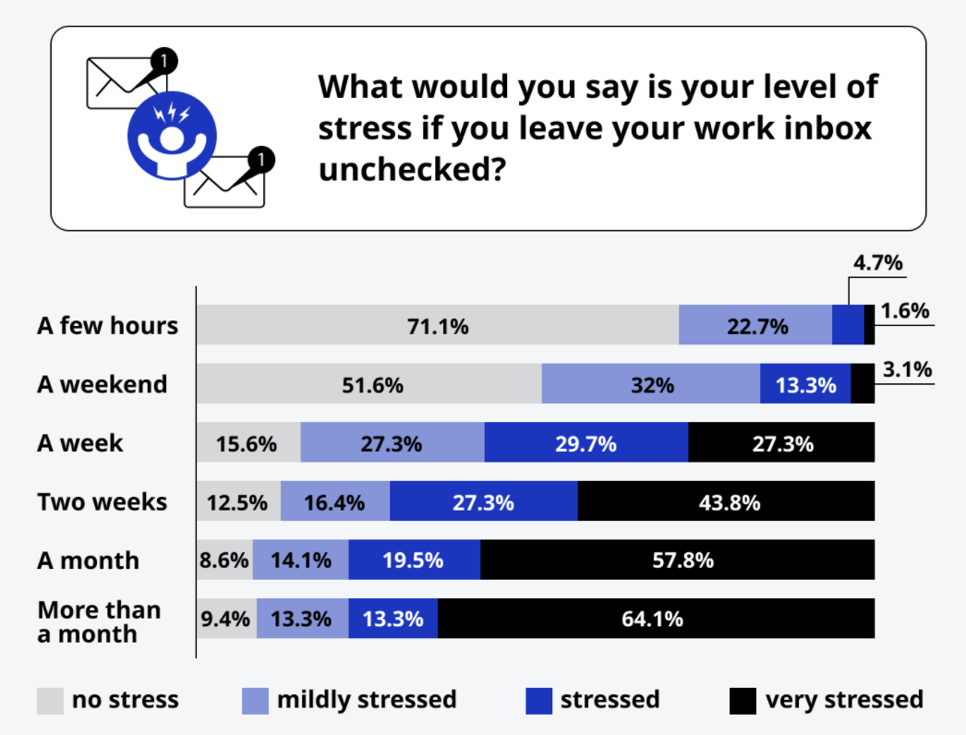
Introduction
3.9 billion active email users.
American workers will receive an average of 126 emails a day.
82% of workers check email outside of normal business hours.
Business lose $650 billion per year due to unnecessary emails.
Stress levels go up considerably after 2 weeks with nearly 44% saying they would feel very stressed.
Notes:
Talking points : Why do we need email classification? Why should you care about it?

Slide 3

About the Client
University of North Texas (UNT) is a public research university which consists of 14 colleges and schools in Denton, Texas.
Our Client is Graduate Admission department of College of Business which has approximately 8000 students and is growing exponentially.
The admission process is a 2-tier process.
All the students send documents on email to respective departments.

Slide 4
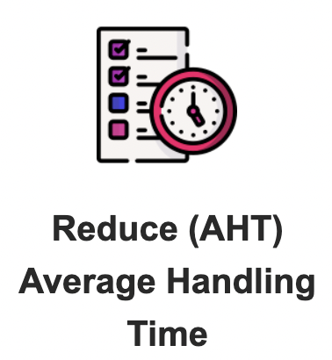


Business Problem
The graduate admission process at College of Business is a manual process.
They receive thousands of emails containing unstructured, free-form text, attachments and even images.
Timely review, acknowledgment and routing to right people is critical.
However, email triage at this scale involving people to review and route to the right departments takes time and precious resources.
Reinventing the process with an automated email classification system to improve the customer experience.
But Do we even need an AI solution?
Notes:
Do we need an AI solution?

Slide 5




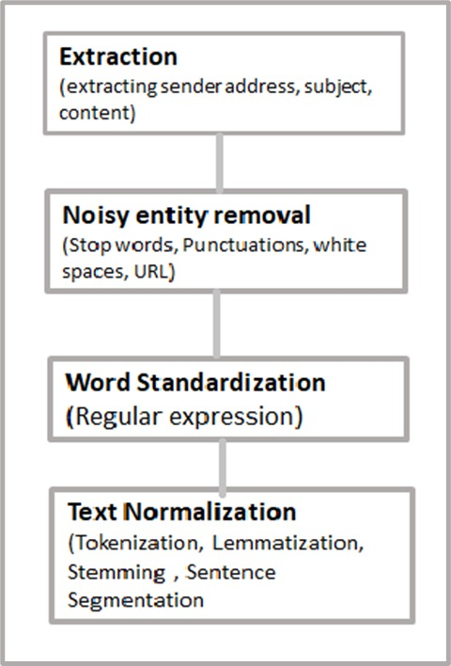
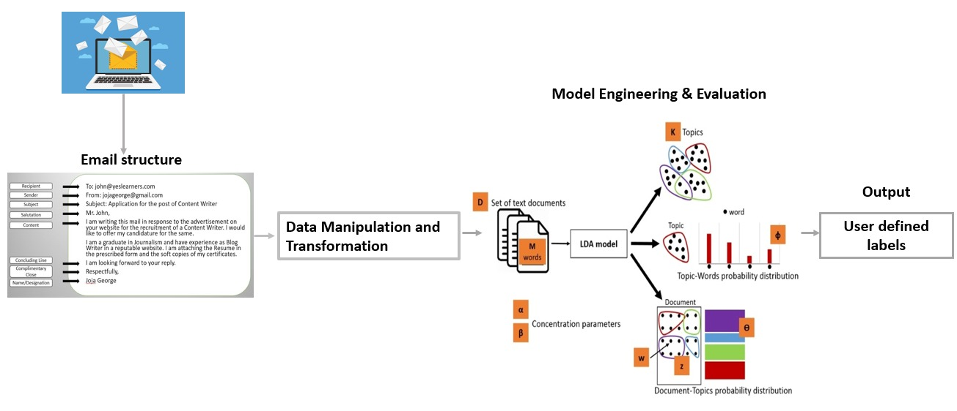
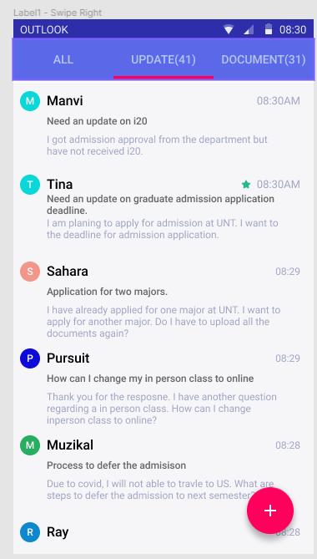
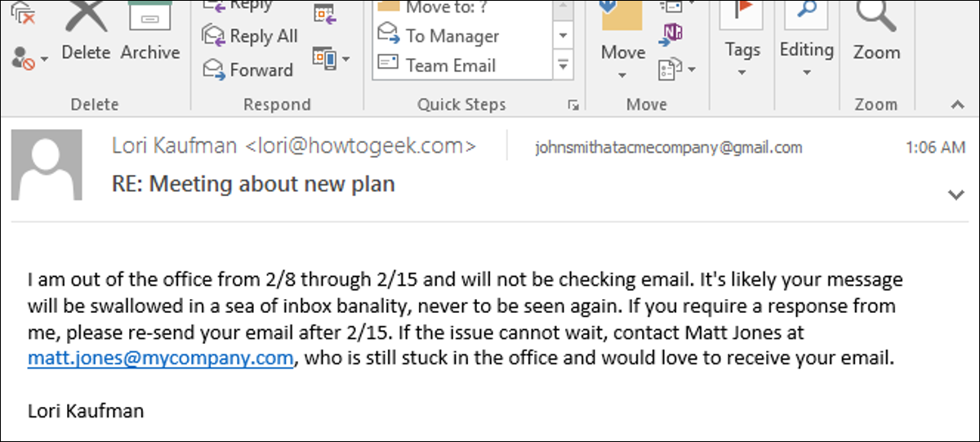
Solution Architecture
Input Data
Data Transformation and Manipulation
Analytics Engine
Implementation
Unstructured Texts
Textual Data & Manipulation
Analytics
Visualization / Reporting

Slide 6
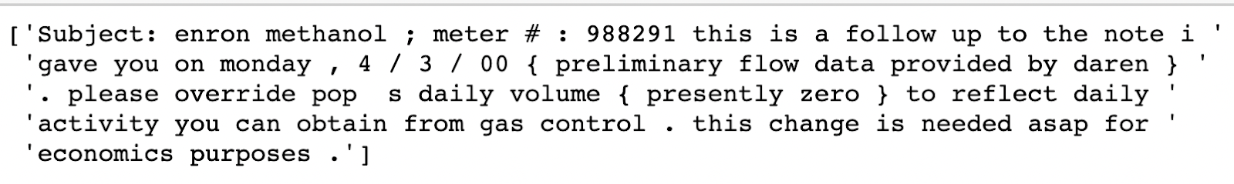
Data Manipulation and Transformation
Data Sample
Collecting admission data is difficult as it has a lot of confidential text, we took a sample dataset “Enron Corporation”, which deals with email data too.
Data Cleaning
Removing regular expressions, punctuations, spelling correction
Tokenization
Breaking up a sequence of strings into pieces such as words, keywords, phrases, symbols and other elements called tokens.
Lemmatization & Stemming
Reducing a word to its word stem that affixes to suffixes and prefixes or to the roots of words known as lemma. stemming is to reduce the total number of unique words in the dictionary.

Slide 7
Analytical Engine: LDA model

Slide 8
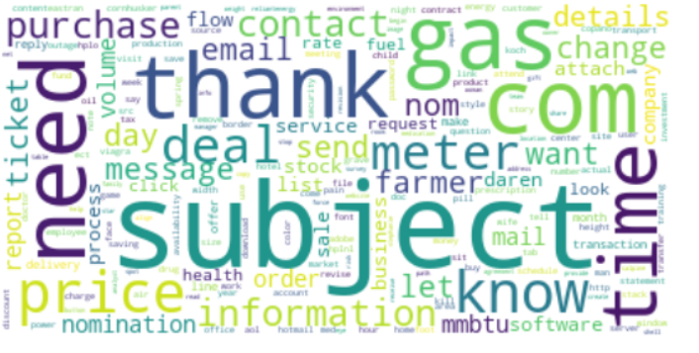
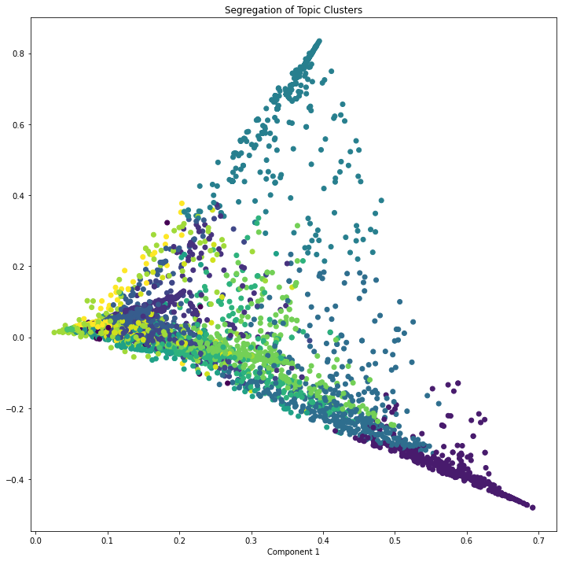
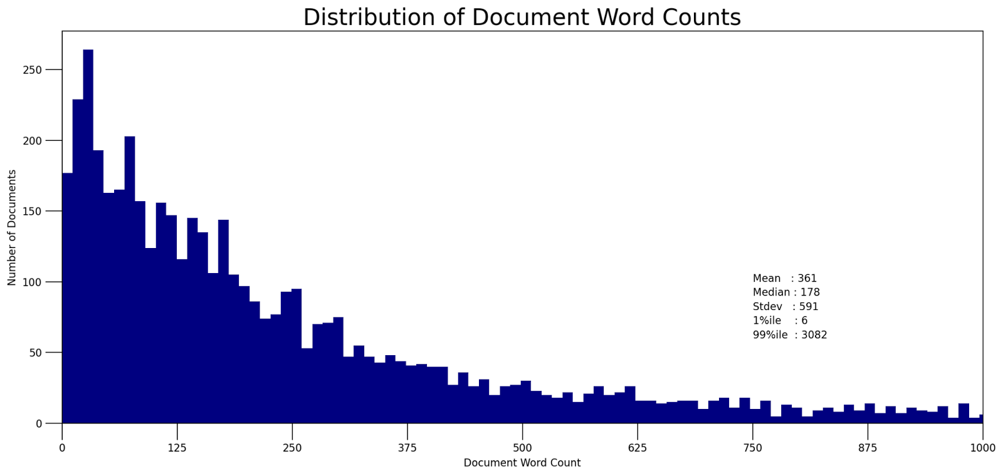
Data Visualization

Slide 9
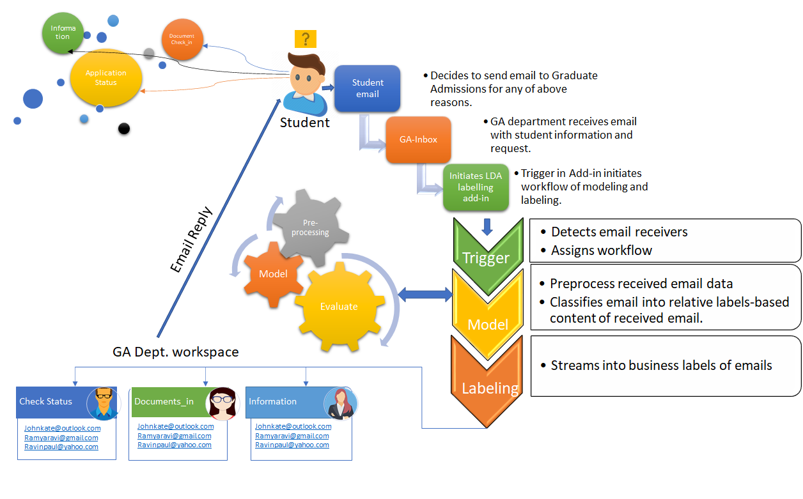
Implementation

Slide 10

Prototype

Slide 11

Conclusion
Implemented the addition of automatic robust labeling outlook add-in for the Graduate Admission office.
Concept of labeling is put forth to save time and reduce the manual work for the employees.
In future, email servers or applications will be able to include different types of pre-defined folders.
It should allow users to add new folders that can be user defined or automatically defined.

Slide 12

Any Questions?

